Slide 1
Arduino I2C
I2C (Inter-Integrated Circuit) is serial bus interface connection protocol. It is also called as TWI (two wire interface) since it uses only two wires for communication. Those two wires are SDA (serial data) and SCL (serial clock).
I2C is an acknowledgment-based communication protocol i.e. transmitter checks for an acknowledgment from the receiver after transmitting data to know whether data is received by receiver successfully.

Slide 2
I2Cworks in two modes namely,
Master mode
Slave mode
SDA (serial data) wire is used for data exchange in between the master and slave device.
SCL (serial clock) is used for the synchronous clock in between master and slave device.
Master device initiates communication with a slave device. It requires a slave device’s address to initiate conversation. The slave device responds to a master device when it is addressed by a master device.
The I2C device has 7-bit or 10-bit unique address. So, to access these devices, a master must address them by the 7-bit or 10-bit unique address.
I2C is used in many applications like reading RTC (Real-time clock), accessing external EEPROM memory. It is also used in sensor modules like a gyro, magnetometer etc.
I2C protocol uses 2 lines for communication:
Serial Clock (SCL): It is a clock signal. Data will be sent to other devices on clock tick event. Only master device has control over this SCL line.
Serial Data (SDA): It is a serial data line which is used for exchanging data between master and slave device

Slide 3
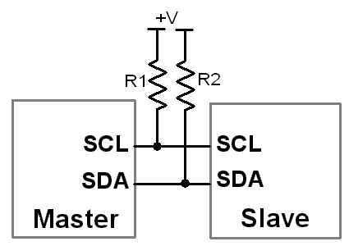

Slide 4
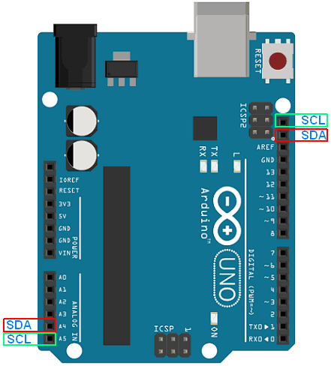

Slide 5
The Arduino Uno board has only one I2C module, but it provides these SDA and SCL line at two different locations. Note: While communicating with devices using I2C communication protocol, pull-up resistors should be used. The value of pull-up resistors may vary depend upon devices used.

Slide 6
The I2C communication bus is very popular and broadly used by many electronic devices because it can be easily implemented in many electronic designs which require communication between a master and multiple slave devices or even multiple master devices.
The easy implementations comes with the fact that only two wires are required for communication between up to almost 128 (112) devices when using 7 bits addressing and up to almost 1024 (1008) devices when using 10 bits addressing.

Slide 7
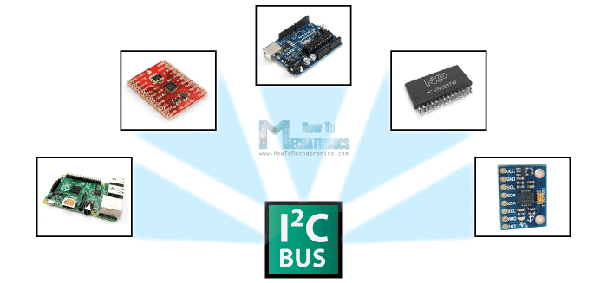

Slide 8
How It Works
How is it possible, a communication between so many devices with just to wires? Well each device has a preset ID or a unique device address so the master can choose with which devices will be communicating.
The two wires, or lines are called Serial Clock (or SCL) and Serial Data (or SDA). The SCL line is the clock signal which synchronize the data transfer between the devices on the I2C bus and it’s generated by the master device. The other line is the SDA line which carries the data.
The two lines are “open-drain” which means that pull up resistors needs to be attached to them so that the lines are high because the devices on the I2C bus are active low. Commonly used values for the resistors are from 2K for higher speeds at about 400 kbps, to 10K for lower speed at about 100 kbps.

Slide 9
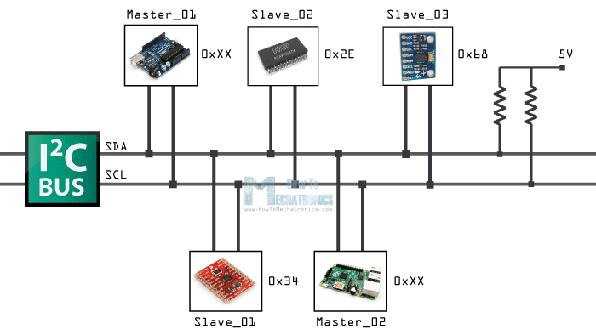

Slide 10
Protocol
The data signal is transferred in sequences of 8 bits.
So after a special start condition occurs comes the first 8 bits sequence which indicates the address of the slave to which the data is being sent.
After each 8 bits sequence follows a bit called Acknowledge. After the first Acknowledge bit in most cases comes another addressing sequence but this time for the internal registers of the slave device.
After the addressing sequences follows the data sequences as many until the data is completely sent and it ends with a special stop condition.

Slide 11
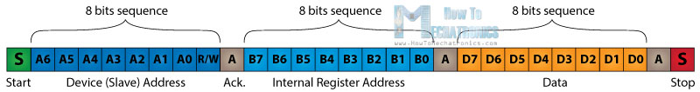

Slide 12
The start condition occurs when data line drops low while the clock line is still high. After this the clock starts and each data bit is transferred during each clock pulse.
The device addressing sequence stars with the most significant bit (MSB) first and ends with the least significant bit (LSB) and it’s actually composed of 7 bits because the 8th bit is used for indicating whether the master will write to the slave (logic low) or read from it (logic high).
The next bit AKC/ NACK is used by the slave device to indicate whether it has successfully received the previous sequence of bits.
So at this time the master device hands the control of the SDA line over to the slave device and if the slave device has successfully received the previous sequence it will pull the SDA line down to the condition called Acknowledge.
If the slave does not pull the SDA line down, the condition is called Not Acknowledge, and means that it didn’t successfully received the previous sequence which can be caused by several reasons. For example, the slave might be busy, might not understand the received data or command, cannot receive any more data and so on. In such a case the master device decides how it will proceed.

Slide 13
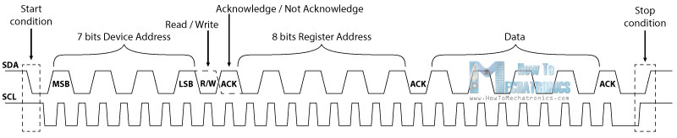
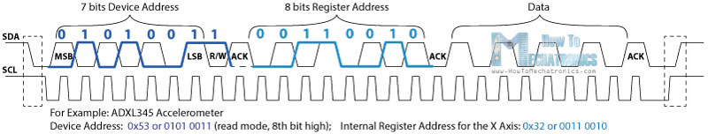

Slide 14
After the addressing, the data transfer sequences begin either from the master or the slave depending of the selected mode at the R/W bit.
After the data is completely sent, the transfer will end with a stop condition which occurs when the SDA line goes from low to high while the SCL line is high.

Slide 15
I2C and Arduino
As an example I will use the GY-80 breakout board which consists 5 different sensors and the GY-521 breakout board which consists 3 different sensors. So we can get data from 8 different sensors with just two wires with the I2C bus.

Slide 16
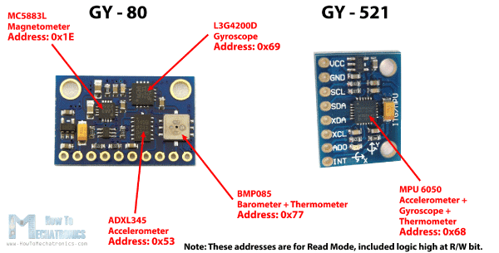

Slide 17
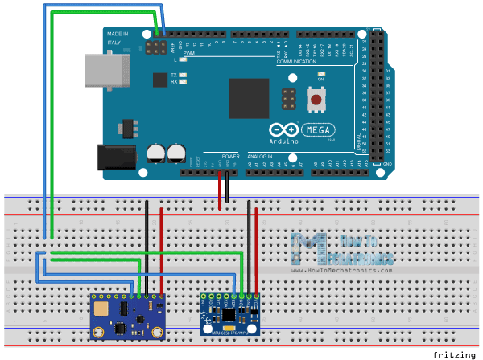

Slide 18
Here’s how we will connect the boards. The Serial Clock pin of the Arduino Board will be connected to the Serial Clock pins of the two breakout boards, the same goes for the Serial Data pins and we will power the boards with the Gnd and the 5V pin from the Arduino Board.

Slide 19
Now in order to communicate with these chips or sensors we need to know their unique addresses.
We can find them from the datasheets of the sensors.
For the GY-80 breakout board we have the following 4 addresses: a hexadecimal 0x53 for the 3 Axis Accelerometer sensor, a hexadecimal 0x69 for the 3 Axis Gyro, a hexadecimal 0x1E for the 3 Axis Magnetometer and a hexadecimal 0x77 for the Barometer and Thermometer sensor.
For the GY-521 breakout board we have only one address and that’s a hexadecimal 0x68.
We can also get or check the addresses using the I2C Scanner sketch which can be found from the Arduino official website.
So here if we upload and run that sketch, we will get the addresses of the connected devices on the I2C bus.

Slide 20
i2c_scanner
The sketch shows the 7-bit addresses of the found devices as hexadecimal values. That value can be used for the "Wire.begin" function which uses the 7-bit address. Some datasheets use the 8-bit address and some example sketches use decimal addresses.

Slide 21
#include <Wire.h>
void setup()
{
Wire.begin();
Serial.begin(9600);
while (!Serial); // Leonardo: wait for serial monitor
Serial.println("\nI2C Scanner");
}
void loop()
{
byte error, address;
int nDevices;
Serial.println("Scanning...");
nDevices = 0;
for(address = 1; address < 127; address++ )
{
// The i2c_scanner uses the return value of
// the Write.endTransmisstion to see if
// a device did acknowledge to the address.
Wire.beginTransmission(address);
error = Wire.endTransmission();
if (error == 0)
{
Serial.print("I2C device found at address 0x");
if (address<16)
Serial.print("0");
Serial.print(address,HEX);
Serial.println(" !");
nDevices++;
}
else if (error==4)
{
Serial.print("Unknown error at address 0x");
if (address<16)
Serial.print("0");
Serial.println(address,HEX);
}
}
if (nDevices == 0)
Serial.println("No I2C devices found\n");
else
Serial.println("done\n");
delay(5000); // wait 5 seconds for next scan
}

Slide 22
I2C functions for Arduino
Wire.write (data)
It is used to write (transmit) data to the master or slave device.
Parameter
data it can be single byte value, string, array of data.
Returns
No. of bytes written.
e.g. Wire.write(7); //send data byte
Wire.write(“i2c”); //send string to slave device
Wire.write(a, 6); //here a is an array
Wire.available()
This function is used by a master or slave to check the requested data is available or not. It returns the no. of bytes available.
Wire.read()
It is used to read the requested data by master from slave or read the data transmitted from a master to a slave.

Slide 23
Functions for Arduino I2C Master
Note: Every I2C slave device has unique address. While communicating using I2C protocol, this slave address needs to be used by Master.
Arduino has Wire Library which allows us to communicate with I2C devices.
Wire.begin ()
It initiates the Wire library and joins the bus as a master.
Wire.beginTransmission (slave address)
This function begins a transmission with the I2C slave device having specified slave address.
slave address 7-bit address of device with which we want to communicate.
e.g. Wire.beginTransmission (50) //begin transmission with slave having address 50

Slide 24
Wire. requestFrom(address, no of byte) OR
Wire. requestFrom(address, no of byte, stop)
This function is used by master to request or receive data from slave device.
The requested data can be read by using Wire.read().
Parameters
Address address of device with which we want to communicate
No. of byte no. of byte needs to request
Stop It is a Boolean.
true - send a stop message after the request, releasing the bus,
false - continually send a restart after the request, keeping the connection active
Returns
No. of bytes returned from slave device.
e.g. Wire.requestFrom(50, 4) //request 4 no. of bytes from slave having address 50
Wire.requestFrom(50, 4, true) //will stop receiving data after 4 bytes, releasing bus
Wire.endTransmission()
It ends a transmission to a slave device that was begun by beginTransmission() and transmits the bytes that were queued by write().
Returns
Return byte which indicate the status of transmission

Slide 25
Functions for Arduino I2C Slave
Wire.begin (address)
It initiates the Wire library and joins the I2C bus as a slave with specified address.
Parameter
Address 7-bit slave address, if not specified then join the bus as master
Wire.onReceive(handler)
The handler function to be called when a slave device receives a transmitted data from a master.

Slide 26
void setup()
{
Wire.begin(8); // join i2c bus with address #8 Wire.onReceive(receiveEvent); // register event Serial.begin(9600); // start serial for output
}
void receiveEvent (int howmany)
{
while (1 < Wire.available())
{ // loop through all but the last
char c = Wire.read(); // receive byte as a character
Serial.print(c); // print the character
}
}

Slide 27
Wire.onRequest (handler)
Handler function to be called when master requests from slave device, takes no parameters and returns nothing.

Slide 28
void setup()
{
Wire.begin(8); // join i2c bus with address #8 Wire.onRequest(requestEvent); // register event
}
void loop()
{ delay(100);
} // function that executes whenever data is requested
//by master
// this function is registered as an event, see setup ()
void requestEvent()
{
Wire.write("hello "); // respond with message of
//6 bytes as expected by master
}

Slide 29
I2C Communication between Two Arduino
Transfer data from master to the slave device. Here, we will use two Arduino one as master and other as slave.
we will be using the built-in example of Wire library provided by Arduino along with their IDE for I2C communication.
From Wire library, we are using here master_writer for Arduino as master and slave_receiver for Arduino as a slave. This example will transfer number from master to slave and slave display it on a serial monitor.
You can use this library from
File -> Examples -> Wire -> master_writer
File -> Examples -> Wire -> master_receiver

Slide 30
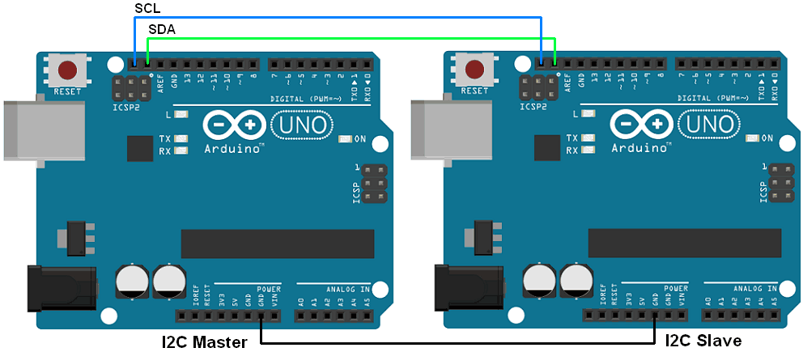

Slide 31
Sketch for Arduino as a master writer
#include <Wire.h>
void setup()
{ Wire.begin(); // join i2c bus (address optional for master)
}
byte x = 0;
void loop()
{
Wire.beginTransmission(8); // transmit to device #8
Wire.write("x is "); // sends five bytes
Wire.write(x);
// sends one byte
Wire.endTransmission(); // stop transmitting
x++;
delay(500);
}

Slide 32
Sketch for Arduino as Slave receiver
#include <Wire.h>
void setup()
{
Wire.begin(8); // join i2c bus with address #8
Wire.onReceive(receiveEvent);
// register event Serial.begin(9600);
// start serial for output
}
void loop()
{ delay(100);
} // function that executes whenever data is received from master
// this function is registered as an event, see setup()
void receiveEvent(int howMany)
{
while (1 < Wire.available())
{
// loop through all but the last
char c = Wire.read(); // receive byte as a character
Serial.print(c); // print the character
}
int x = Wire.read(); // receive byte as an integer
Serial.println(x); // print the integer
}

Slide 33
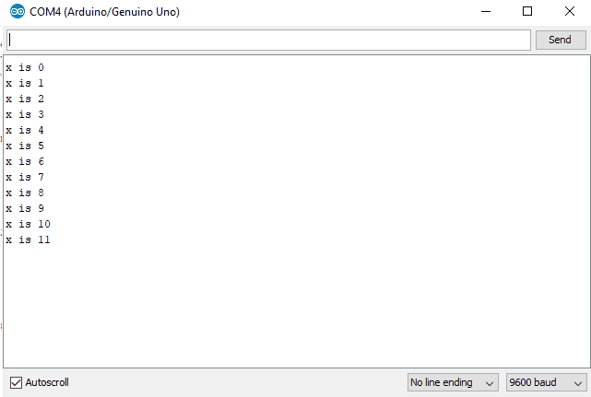

Slide 34
Two-way communication between two Arduino using I2C
Let’s write a program where we will send Hello message to slave and slave will respond back to the received message with Hi. Two Arduino Unos are used as master and Slave.

Slide 35
Sketch for Master
#include <Wire.h>
void setup()
{
Serial.begin(9600); /* begin serial comm. */ Wire.begin(); /* join i2c bus as master */ Serial.println("I am I2C Master");
}
void loop()
{ Wire.beginTransmission(8); /* begin with device address 8 */
Wire.write("Hello Slave"); /* sends hello string */ Wire.endTransmission(); /* stop transmitting */ Wire.requestFrom(8, 9); /* request & read data of size 9 from slave */
while(Wire.available())
{ char c = Wire.read();/* read data received from slave */
Serial.print(c);
}
Serial.println();
delay(1000);
}

Slide 36
Sketch for Slave
#include <Wire.h>
void setup()
{
Wire.begin(8); /* join i2c bus with address 8 */
Wire.onReceive(receiveEvent); /* register receive event */
Wire.onRequest(requestEvent); /* register request event */
Serial.begin(9600); /* start serial comm. */
Serial.println("I am I2C Slave");
}
void loop()
{ delay(100);
} // function that executes whenever data is received from master
void receiveEvent(int howMany)
{ while (0 <Wire.available())
{ char c = Wire.read(); /* receive byte as a character */
Serial.print(c); /* print the character */
} Serial.println(); /* to newline */
} // function that executes whenever data is requested from master
void requestEvent()
{
Wire.write("Hi Master"); /*send string on request */
}

Slide 37
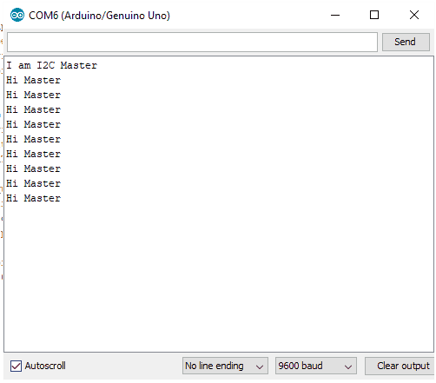
Master’s Serial Monitor Output

Slide 38
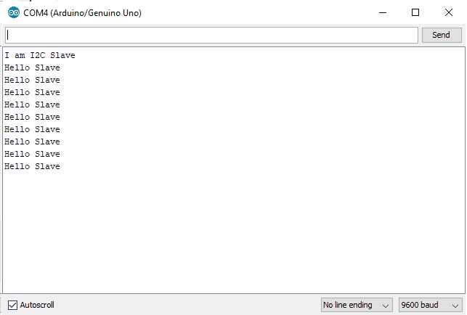
Slave’s Serial Monitor Output

Slide 39
Adding a New Library to Arduino IDE and Using It
how to add a library for MPU6050 (Gyroscope + Accelerometer + Temperature) module.
using Korneliusz Jarzebski’s MPU6050 library from GitHub.
Download and extract the library and add its folder in the libraries folder of Arduino IDE.
The library folder in Arduino already consists of many libraries like WiFi, GSM, etc. Hence, their folders are present from the time of download of the Arduino IDE.

Slide 40
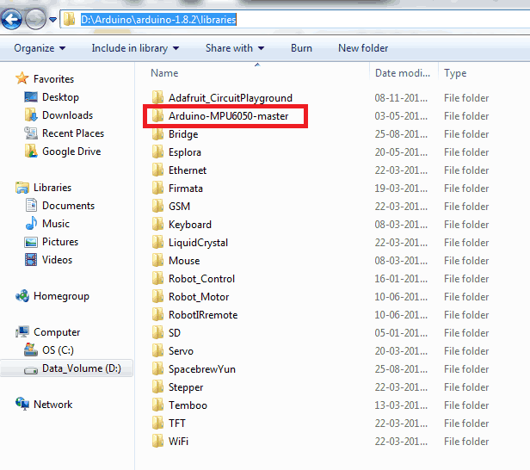

Slide 41
Once this is done, open the Arduino IDE. We can find the examples from the added library in the Examples tab under Examples for any board as shown below.
Note : If you had the Arduino IDE open while adding any library, you will need to close the IDE and open it again for it to appear in the Examples tab.

Slide 42
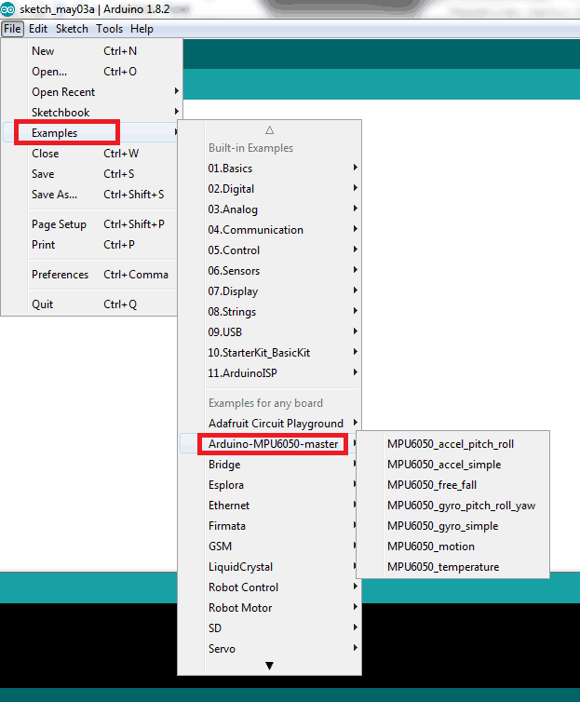

Slide 43
We can select any one of the example sketches from the added library. For example, we can select MPU6050_accel_simple sketch and directly upload it to our board just like we do for built-in examples.
It is also possible to use the functions defined in this library by simply including the header file for this library in the application sketch that we create.

Slide 44
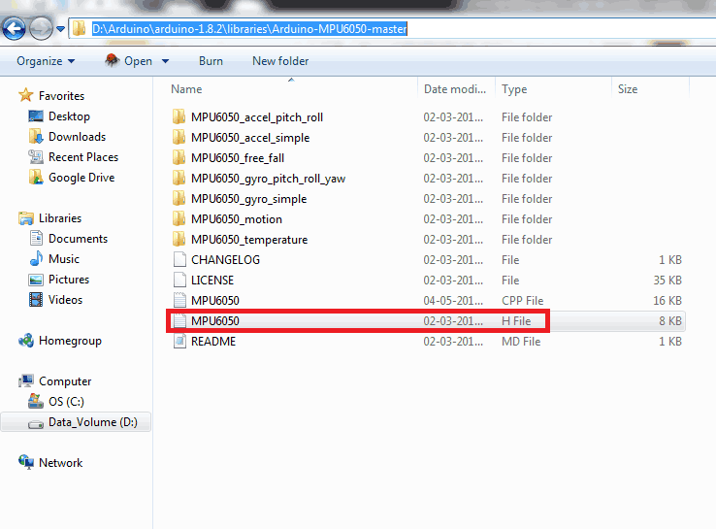

Slide 45
Just like we include standard libraries like stdio.h, string.h, etc.; include the MPU6050.h in your application sketch.
Once this is done, we can use any of the functions that are declared in the MPU6050.h file (defined in the MPU6050.cpp file) in our application sketch.

